Slide 1
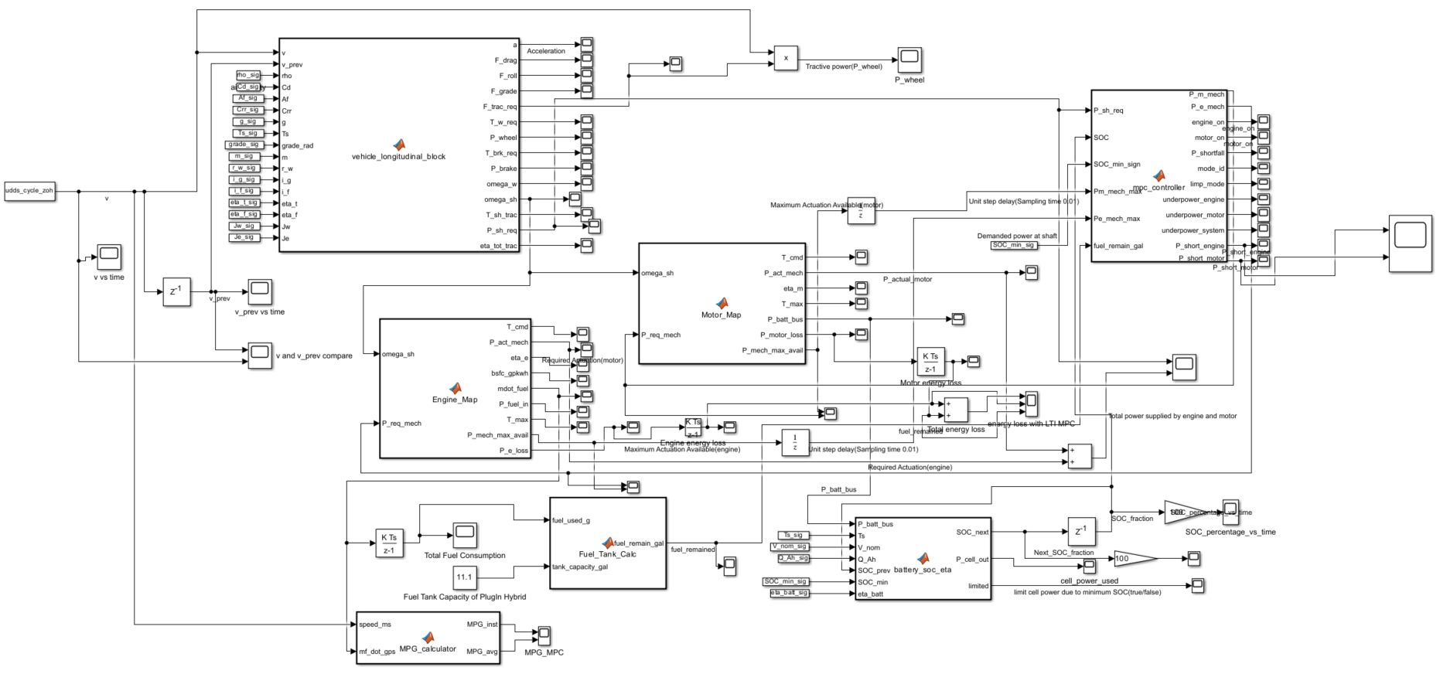
AENG 562
Energy Management of Electrified Vehicles
Project Presentation
a
Energy Optimization of P2 Parallel Plug-in Hybrid Electric Vehicle Without Regen (PHEV)
Presented by:
Yash Panthri
Hesham Aldahbali
Tejas Deodhar

Slide 2
MOTIVATION

Slide 3
Motivation
Transportation sector is a major contributor to fuel consumption and emissions
Electrification improves efficiency and fuel economy but has practical limitations
Plug-in Hybrid Electric Vehicles (PHEVs) combine:
Electrical drive benefits
Long driving range using engine backup
In PHEVs, energy management strategy (EMS) directly impacts:
Fuel consumption
Battery State of Charge (SOC)
Overall vehicle MPG

Slide 4
Why Advanced Control?
Parallel PHEV allows both engine and motor to provide traction power
Traditional strategies:
Fixed or rule-based power splits
No awareness of future power demand
Ignore efficiency variations in engine and motor maps
Model Predictive Control (MPC):
Uses system dynamics
Predicts future behavior over a finite horizon
Optimizes energy usage proactively

Slide 5
PROBLEM STATEMENT

Slide 6
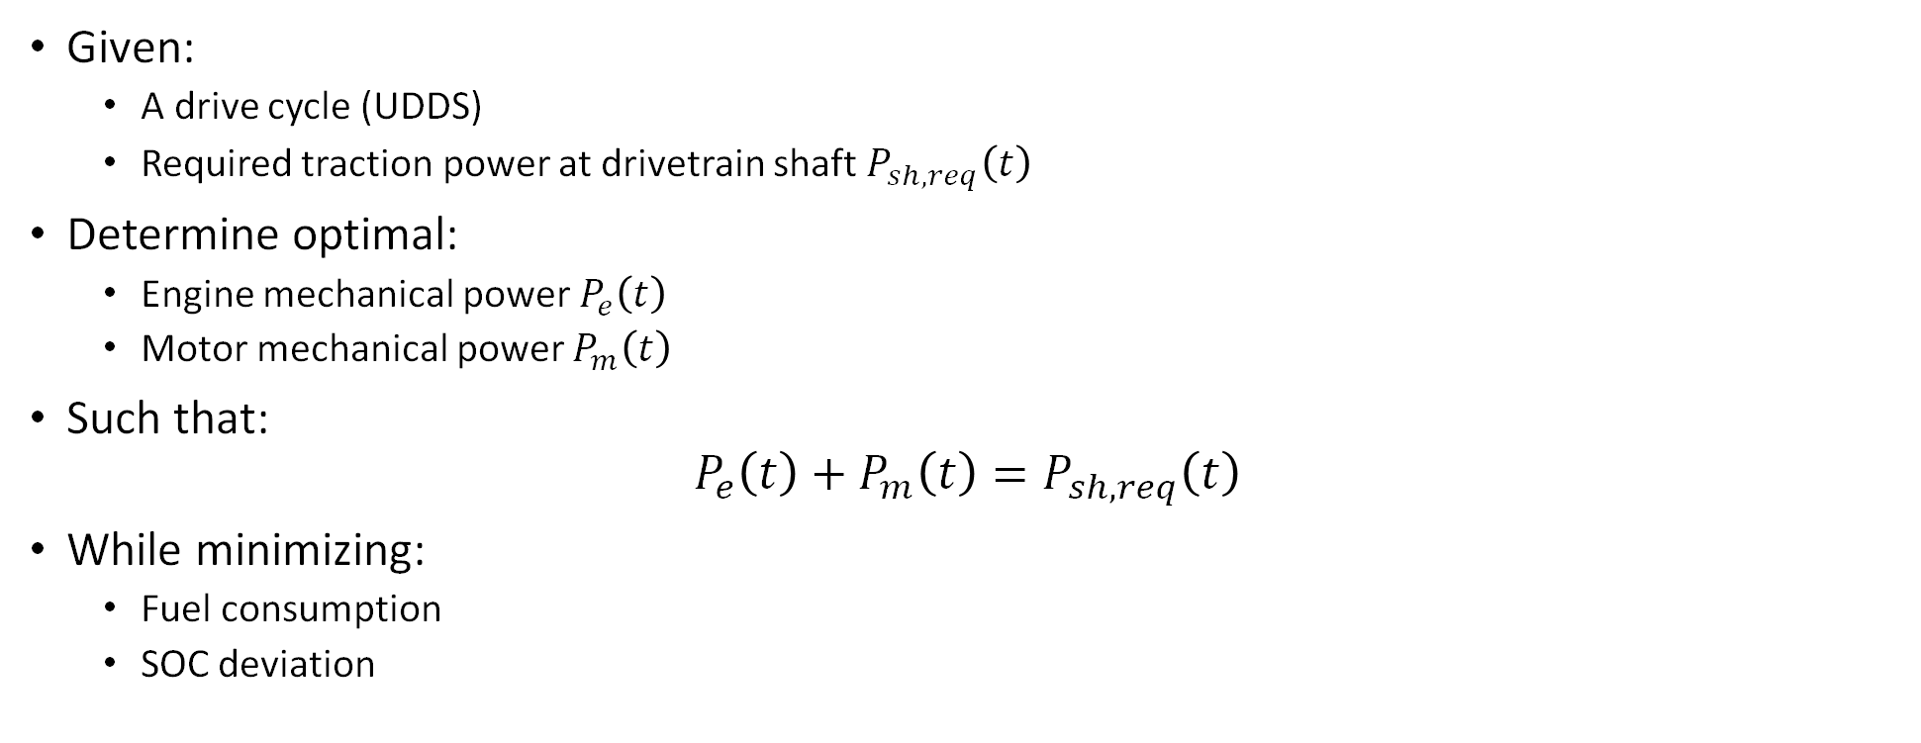
Problem Description
Given:
A drive cycle (UDDS)
Required traction power at drivetrain shaft $P_{sh,req}\left(t\right)$
Determine optimal:
Engine mechanical power $P_{e}\left(t\right)$
Motor mechanical power $P_{m}\left(t\right)$
Such that:
$$P_{e}\left(t\right)+P_{m}\left(t\right)=P_{sh,req}\left(t\right)$$
While minimizing:
Fuel consumption
SOC deviation

Slide 7
Constraints and Objectives
System Constraints
Engine and motor power limits (from ADVISOR maps)
Battery SOC must remain above minimum threshold
No regenerative braking considered
Controllers Compared
50–50 Rule-Based Controller
Equal power split when SOC allows
Simple benchmark strategy
Model Predictive Controller (MPC)
Linear energy-based model
Optimizes power split over prediction horizon

Slide 8
MODEL

Slide 9
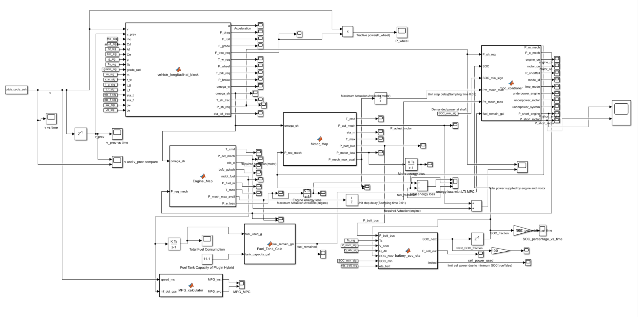

Slide 10
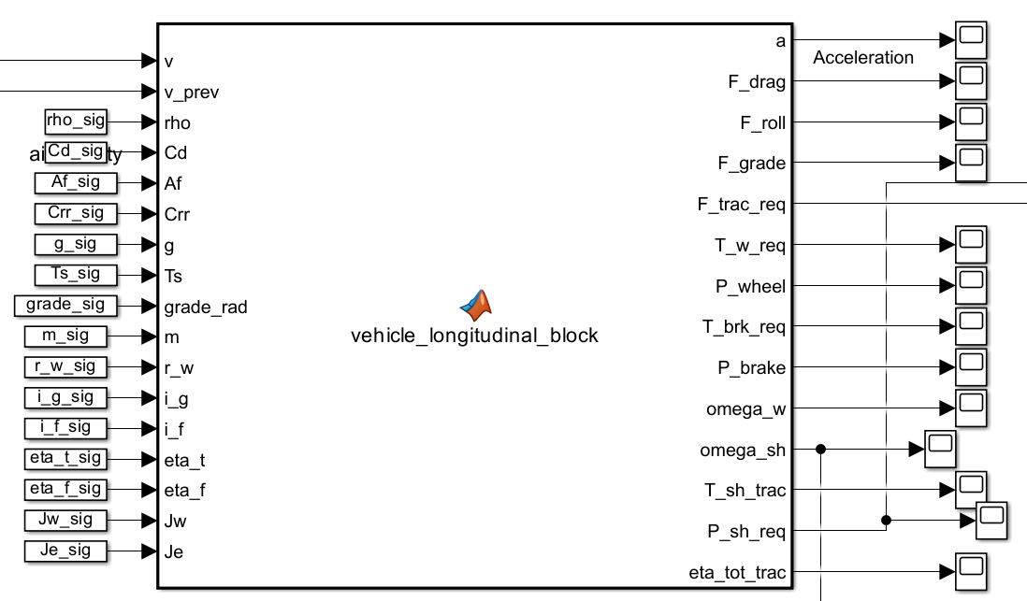
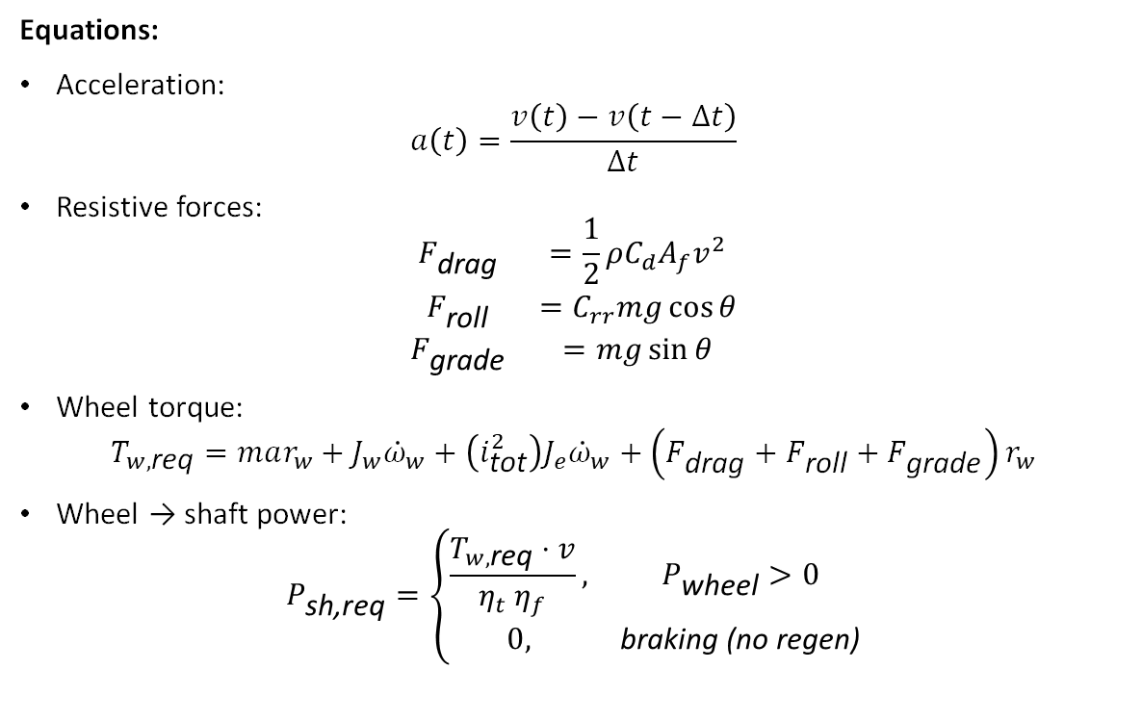
1. Vehicle Longitudinal Dynamics Model
Equations:
Acceleration:
$$a\left(t\right)=\frac{v\left(t\right)−v\left(t−Δt\right)}{Δt}$$
Resistive forces:
$$\begin{matrix}F_{\text{drag}} & =\frac{1}{2}ρC_{d}A_{f}v^{2} \\ F_{\text{roll}} & =C_{rr}mg\cos{θ} \\ F_{\text{grade}} & =mg\sin{θ}\end{matrix}$$
Wheel torque:
$$T_{w,\text{req}}=mar_{w}+J_{w}{\dot{ω}}_{w}+\left(i_{\text{tot}}^{2}\right)J_{e}{\dot{ω}}_{w}+\left(F_{\text{drag}}+F_{\text{roll}}+F_{\text{grade}}\right)r_{w}$$
Wheel → shaft power:
$$P_{\text{sh}\text{,}\text{req}}=\left\{\begin{matrix}\frac{T_{w,\text{req}}⋅v}{η_{t} η_{f}}, & P_{\text{wheel}}>0 \\ 0, & \text{braking}\text{ (}\text{no} \text{regen}\text{)}\end{matrix}\right.$$

Slide 11
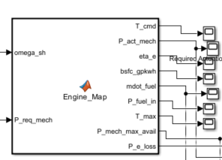
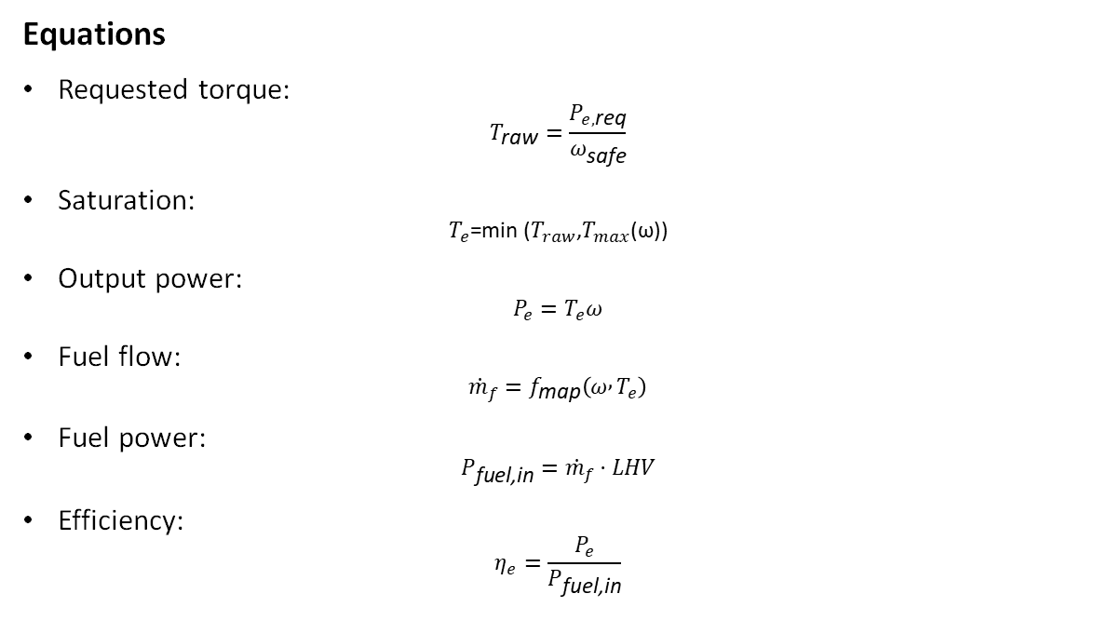
2. Engine Map Model (from ADVISOR FC_SI63_emis)
Speed breakpoints: 701–5500 rpm
Torque breakpoints: 0–100 Nm
Fuel map: fc_fuel_map (g/s)
Max torque curve: fc_max_trq
Equations
Requested torque:
$$T_{\text{raw}}=\frac{P_{e,\text{req}}}{ω_{\text{safe}}}$$
Saturation:
$$\text{​}T_{e}\text{=}\text{min} \text{(}T_{raw}\text{​,}T_{max}\text{​​(}\text{ω}\text{))}$$
Output power:
$$P_{e}=T_{e}ω$$
Fuel flow:
$${\dot{m}}_{f}=f_{\text{map}}\left(ω , T_{e}\right)$$
Fuel power:
$$P_{\text{fuel}\text{,}\text{in}}={\dot{m}}_{f}⋅LHV$$
Efficiency:
$$η_{e}=\frac{P_{e}}{P_{\text{fuel}\text{,}\text{in}}}$$

Slide 12
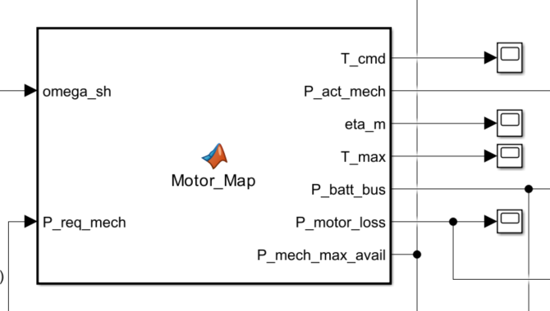
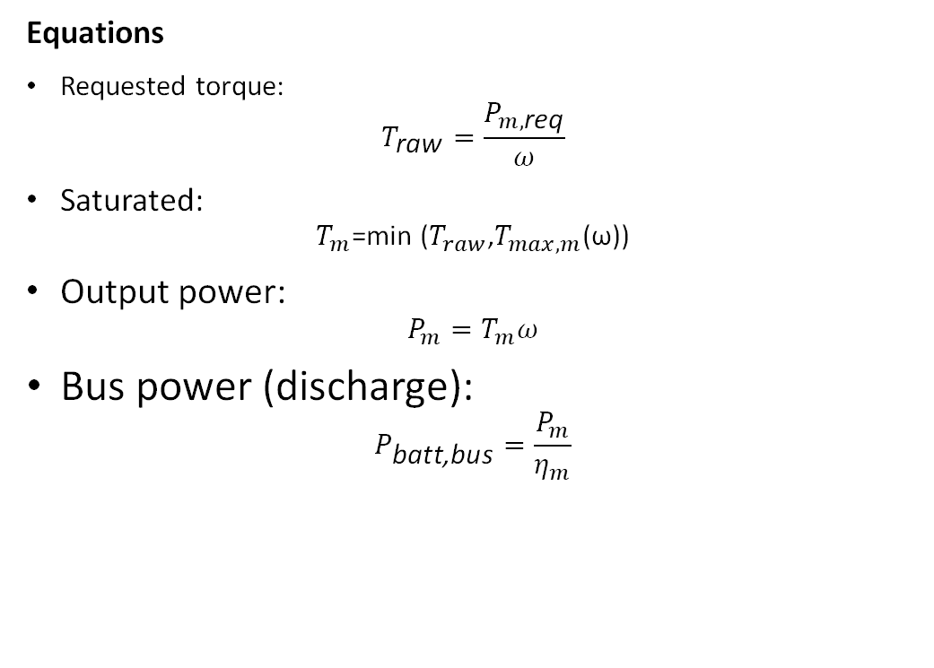
3. Motor Map Model (from ADVISOR MC_PM49)
Speed axis: 0–8500 rpm
Torque axis: –176→274 Nm
Efficiency map: mc_eff_map
Max motoring torque: mc_max_trq
Equations
Requested torque:
$$T_{\text{raw}}=\frac{P_{m,\text{req}}}{ω}$$
Saturated:
$$\text{​}T_{m}\text{=}\text{min}\text{ (}T_{raw}\text{​,}T_{max,m}\text{​​(}\text{ω}\text{))}$$
Output power:
$$P_{m}=T_{m}ω$$
Bus power (discharge):
$$P_{\text{batt}\text{,}\text{bus}}=\frac{P_{m}}{η_{m}}$$

Slide 13
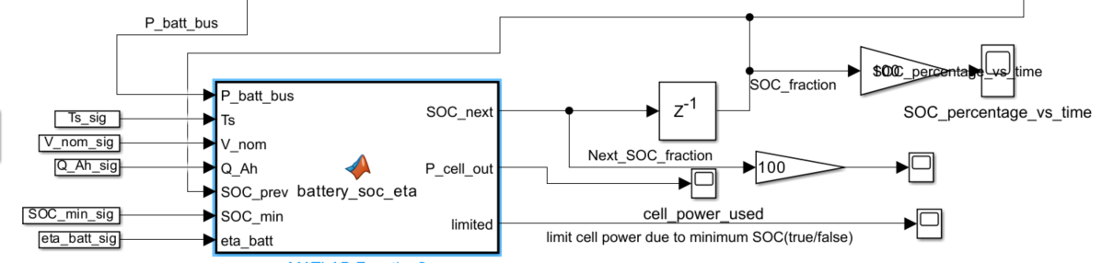
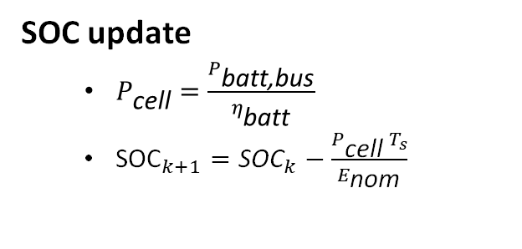
4. Battery SOC Model
SOC update
$P_{\text{cell}}=\frac{P_{\text{batt}\text{,}\text{bus}}}{η_{\text{batt}}}$
${\text{SOC}}_{k+1}={\text{SOC}}_{k}−\frac{P_{\text{cell}} T_{s}}{E_{\text{nom}}}$

Slide 14
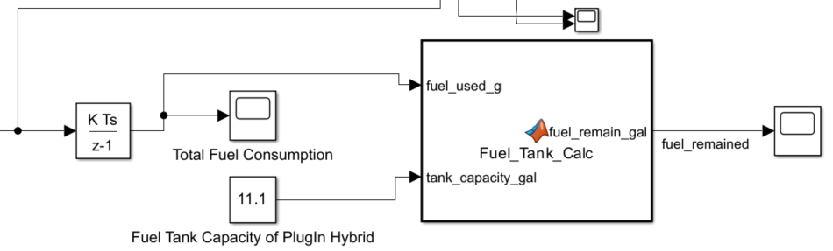
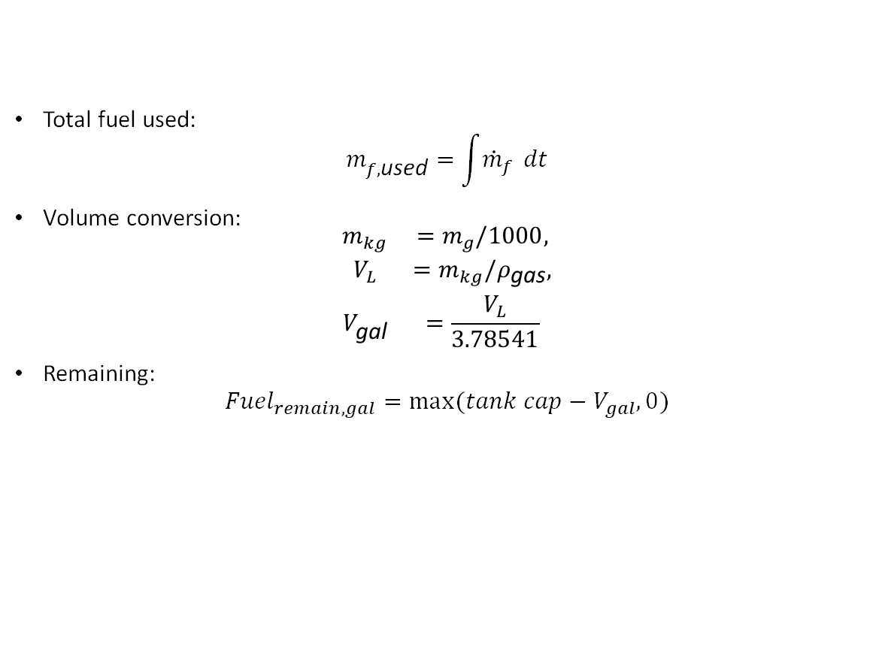
5. Fuel Tank Model
Total fuel used:
$$m_{f,\text{used}}=\int{{\dot{m}}_{f}} dt$$
Volume conversion:
$$\begin{matrix}m_{kg} & =m_{g}/1000, \\ V_{L} & =m_{kg}/ρ_{\text{gas}}, \\ V_{\text{gal}} & =\frac{V_{L}}{3.78541}\end{matrix}$$
Remaining:
$${Fuel}_{remain,gal}=\max{(tank cap−V_{gal},0)}$$

Slide 15
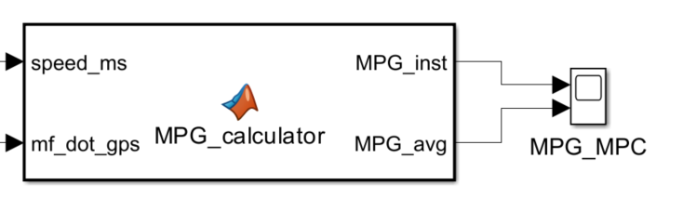
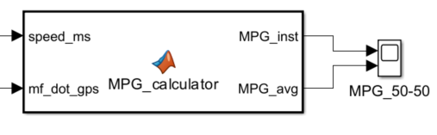
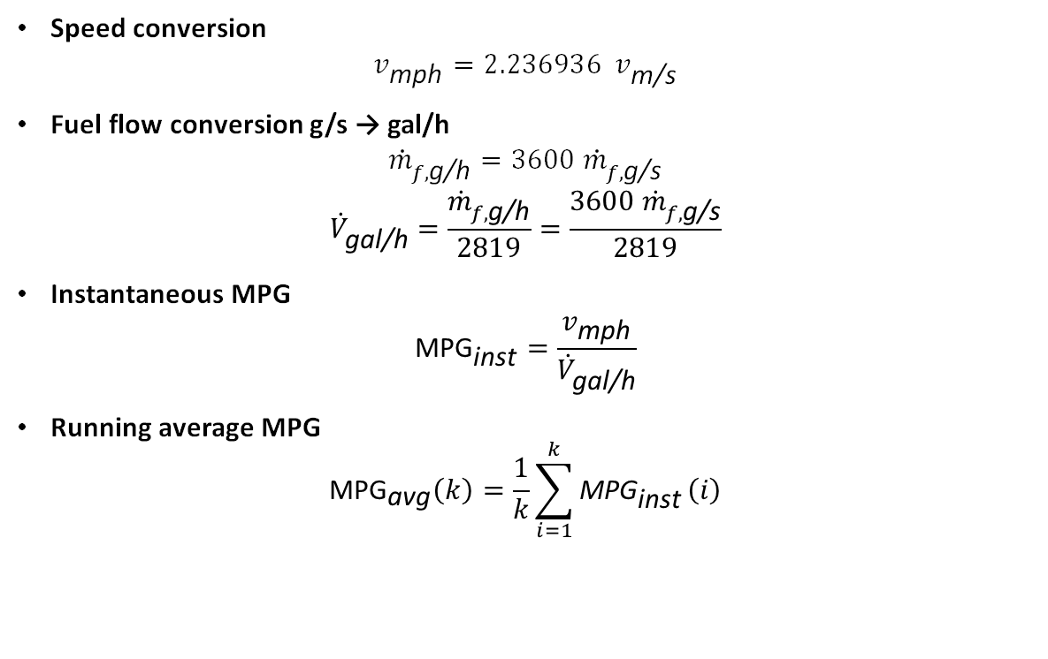
6. MPG calculator
Speed conversion
$$v_{\text{mph}}=2.236936 v_{\text{m}\text{/}\text{s}}$$
Fuel flow conversion g/s → gal/h
$${\dot{m}}_{f,\text{g}\text{/}\text{h}}=3600 {\dot{m}}_{f,\text{g}\text{/}\text{s}}$$
$${\dot{V}}_{\text{gal}\text{/}\text{h}}=\frac{{\dot{m}}_{f,\text{g}\text{/}\text{h}}}{2819}=\frac{3600 {\dot{m}}_{f,\text{g}\text{/}\text{s}}}{2819}$$
Instantaneous MPG
$${\text{MPG}}_{\text{inst}}=\frac{v_{\text{mph}}}{{\dot{V}}_{\text{gal}\text{/}\text{h}}}$$
Running average MPG
$${\text{MPG}}_{\text{avg}}\left(k\right)=\frac{1}{k}\sum_{i=1}^{k}{{\text{MPG}}_{\text{inst}}}\left(i\right)$$

Slide 16
Energy Management System Design

Slide 17
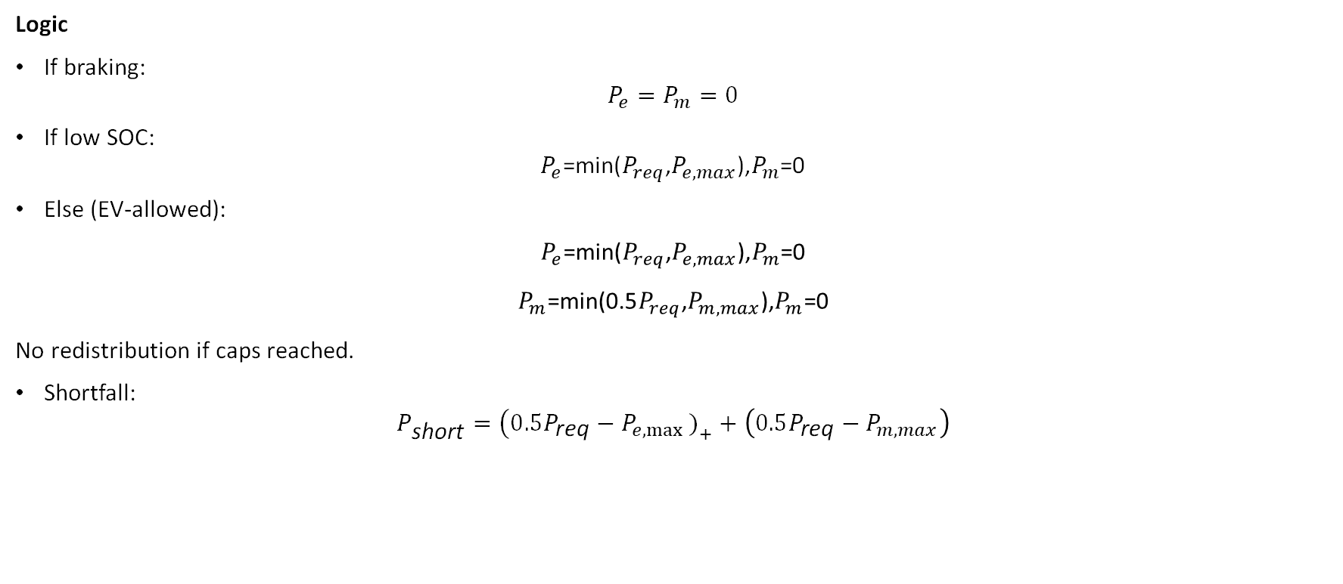
50 / 50 Rule-Based Controller
Logic
If braking:
$$P_{e}=P_{m}=0$$
If low SOC:
$$P_{e}\text{​=}\text{min}\text{(}P_{req}\text{,}P_{e,max}\text{​),}P_{m}\text{​=}\text{0}$$
Else (EV-allowed):
$$P_{e}\text{​=}\text{min}\text{(}P_{req}\text{,}P_{e,max}\text{​),}P_{m}\text{​=}\text{0}$$
$$P_{m}\text{​=}\text{min}\text{(}\text{0}\text{.}\text{5}P_{req}\text{,}P_{m,max}\text{​),}P_{m}\text{​=}\text{0}$$
No redistribution if caps reached.
Shortfall:
$$P_{\text{short}}=\left(0.5P_{\text{req}}−P_{e,max }{\left.)\right.}_{+}+\left(0.5P_{\text{req}}−P_{m,max}\right)\right.$$

Slide 18
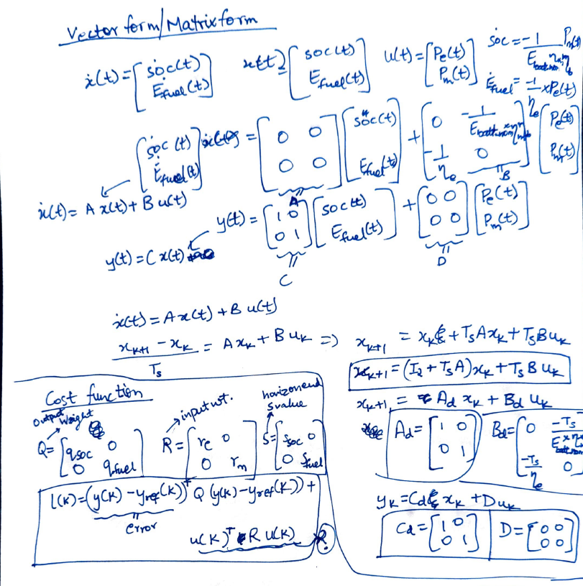
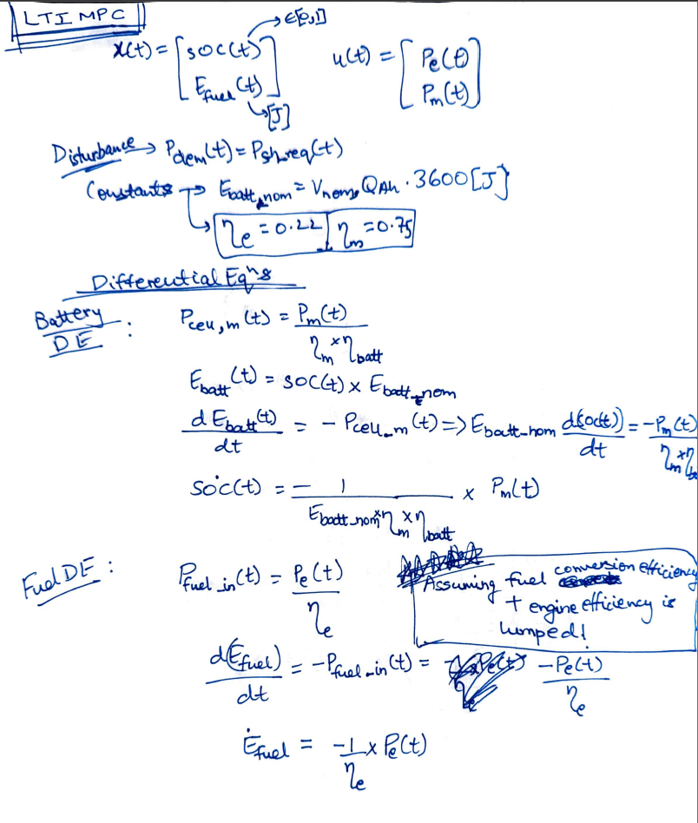
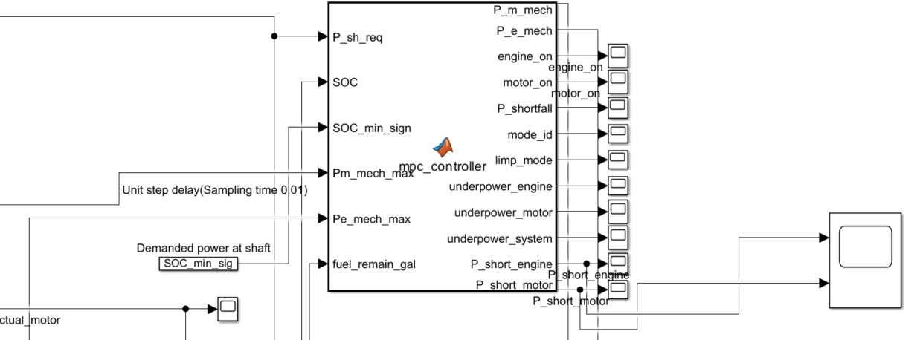
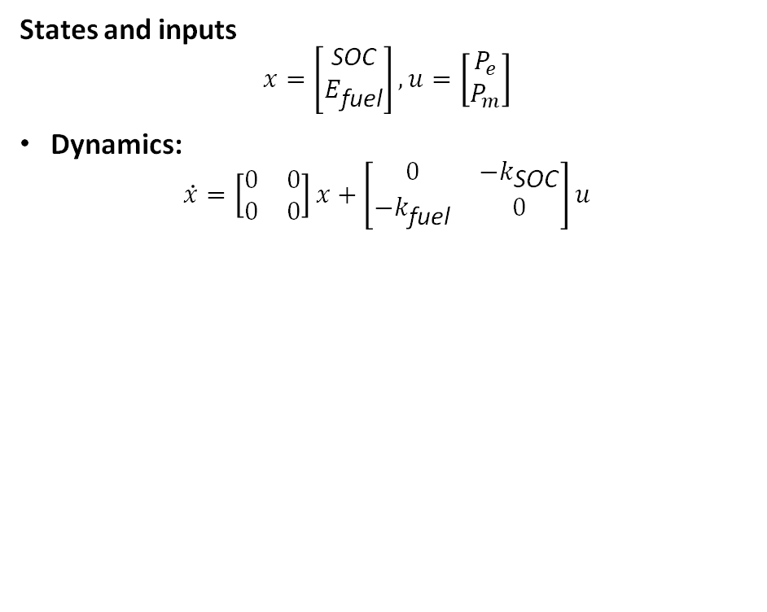
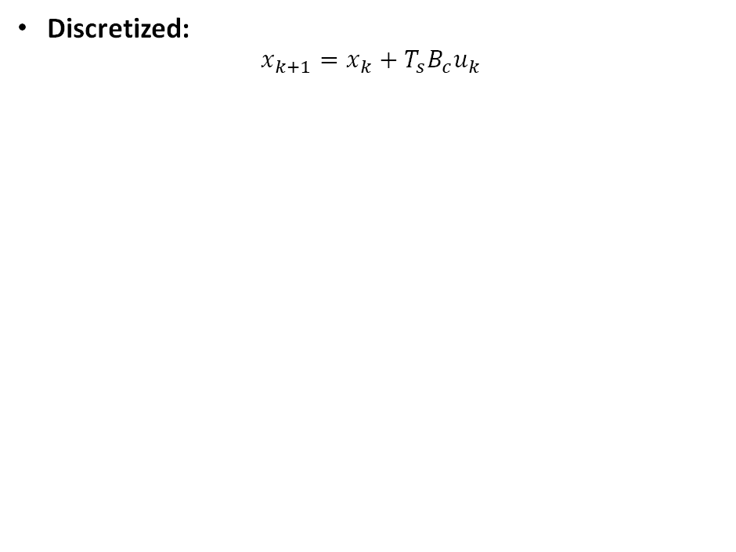
MPC: LTI Energy State Model
States and inputs
$$x=\left[\begin{matrix}\text{SOC} \\ E_{\text{fuel}}\end{matrix}\right], u=\left[\begin{matrix}P_{e} \\ P_{m}\end{matrix}\right]$$
Dynamics:
$$\dot{x}=\left[\begin{matrix}0 & 0 \\ 0 & 0\end{matrix}\right]x+\left[\begin{matrix}0 & −k_{\text{SOC}} \\ −k_{\text{fuel}} & 0\end{matrix}\right]u$$
Discretized:
$$x_{k+1}=x_{k}+T_{s}B_{c}u_{k}$$

Slide 19
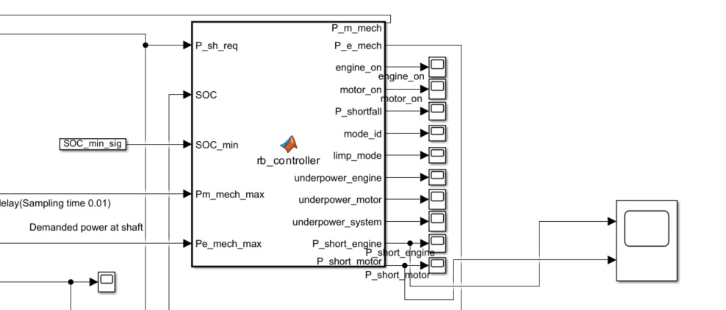
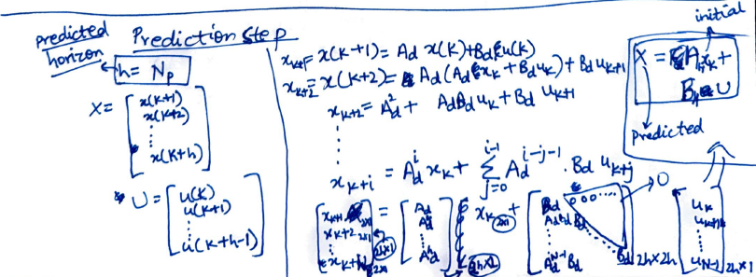
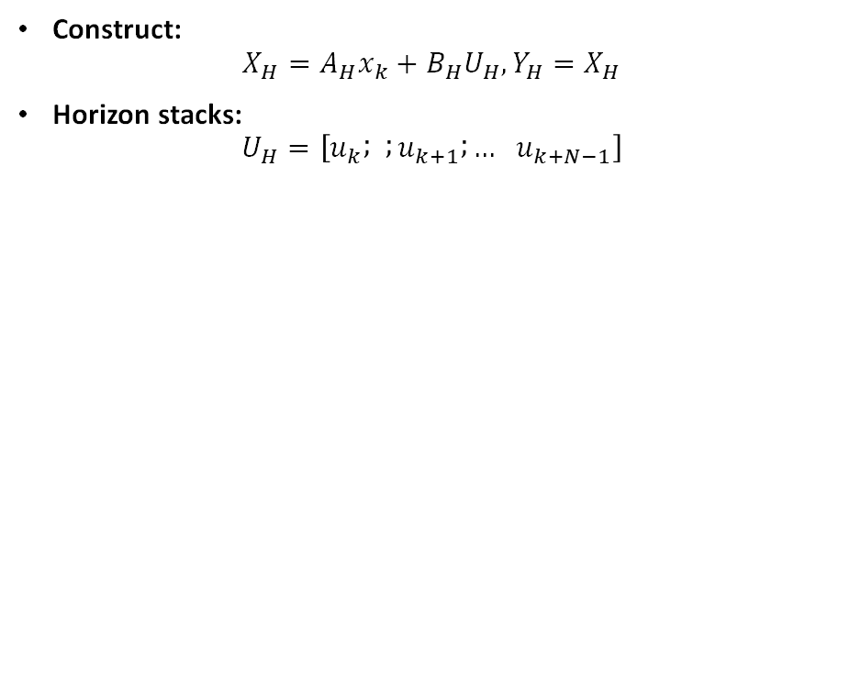
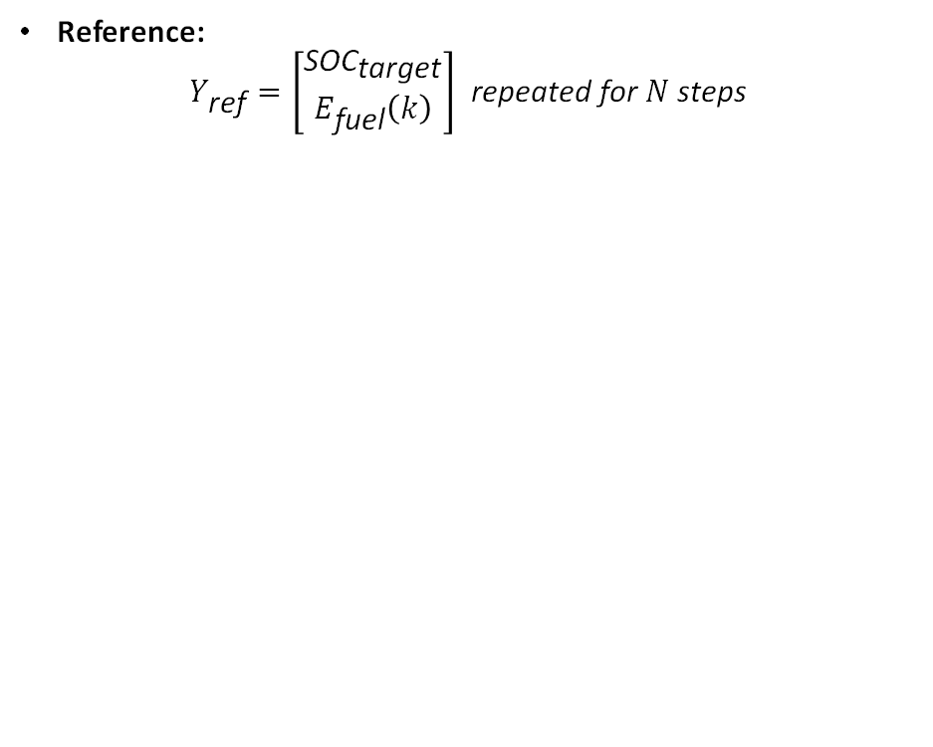
MPC Prediction Model
Construct:
$$X_{H}=A_{H}x_{k}+B_{H}U_{H}, Y_{H}=X_{H}$$
Horizon stacks:
$$U_{H}=\left[u_{k} ; ; u_{k+1} ; … u_{k+N−1}\right]$$
Reference:
$$Y_{\text{ref}}=\left[\begin{matrix}{\text{SOC}}_{\text{target}} \\ E_{\text{fuel}}\left(k\right)\end{matrix}\right] \text{repeated} \text{for} N \text{steps}$$

Slide 20
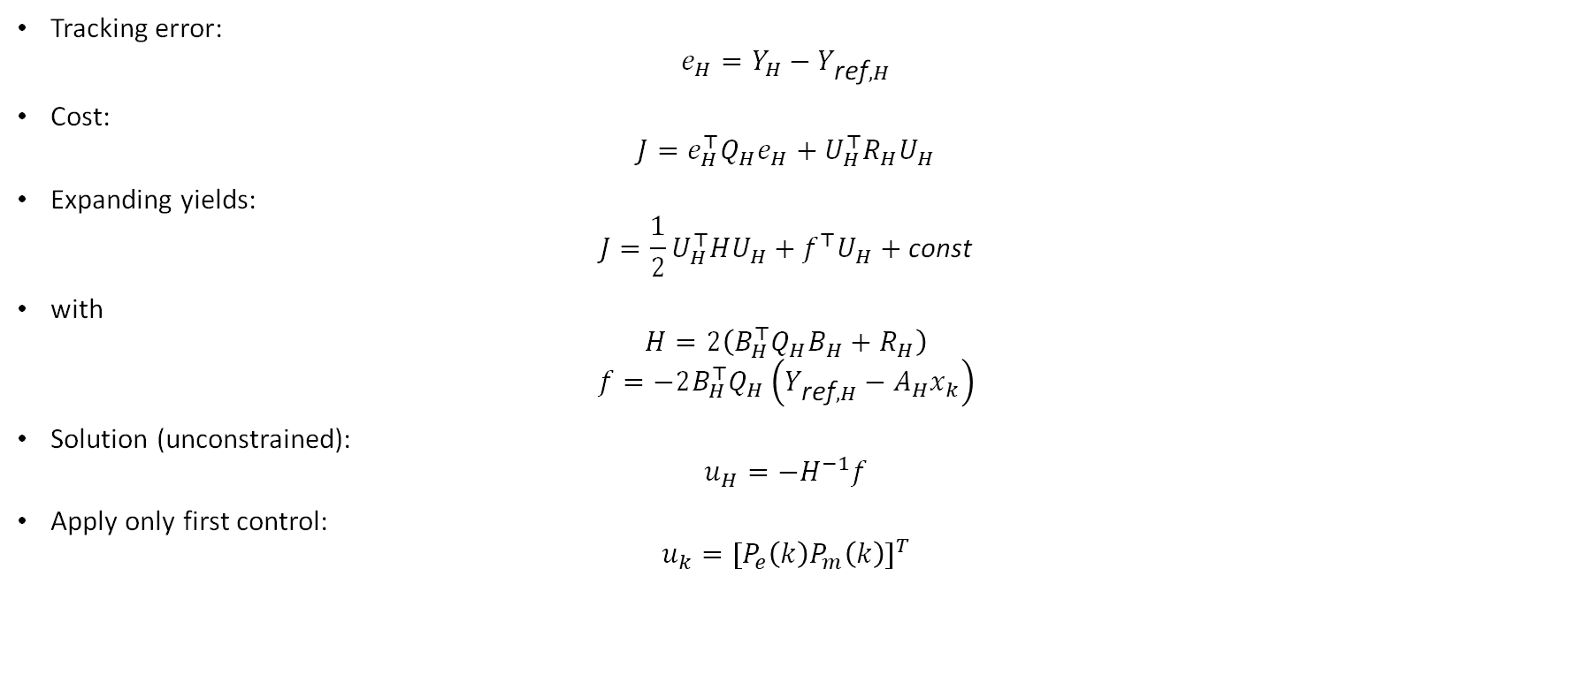
MPC Cost Function
Tracking error:
$$e_{H}=Y_{H}−Y_{\text{ref},H}$$
Cost:
$$J=e_{H}^{⊤}Q_{H}e_{H}+U_{H}^{⊤}R_{H}U_{H}$$
Expanding yields:
$$J=\frac{1}{2}U_{H}^{⊤}HU_{H}+f^{⊤}U_{H}+\text{const}$$
with
$$H=2\left(B_{H}^{⊤}Q_{H}B_{H}+R_{H}\right)$$
$$f=−2B_{H}^{⊤}Q_{H}\left(Y_{\text{ref},H}−A_{H}x_{k}\right)$$
Solution (unconstrained):
$$u_{H}=−H^{−1}f$$
Apply only first control:
$$u_{k}={[P_{e}\left(k\right)P_{m}\left(k\right)]}^{T}$$

Slide 21
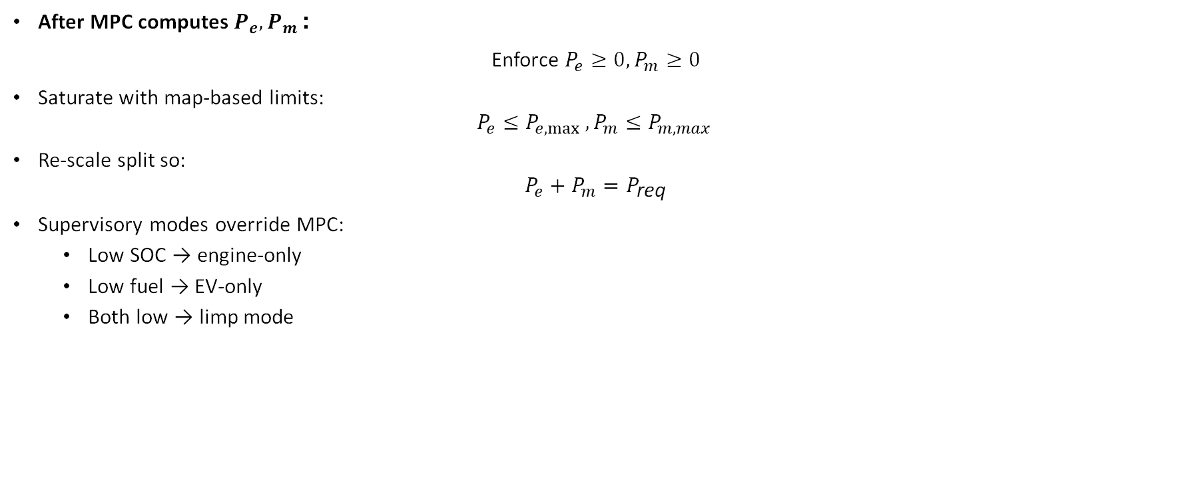
Post-Processing & Constraints
After MPC computes $P_{e},P_{m}$:
Enforce $P_{e}≥0,P_{m}≥0$
Saturate with map-based limits:
$$P_{e}≤P_{e,max }, P_{m}≤P_{m,max }$$
Re-scale split so:
$$P_{e}+P_{m}=P_{\text{req}}$$
Supervisory modes override MPC:
Low SOC → engine-only
Low fuel → EV-only
Both low → limp mode

Slide 22
RESULTS

Slide 23
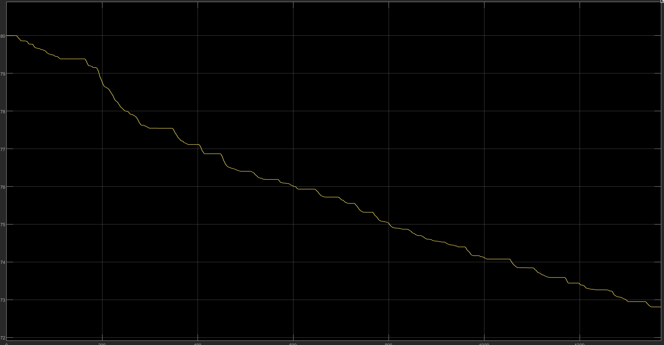
SOC

Slide 24
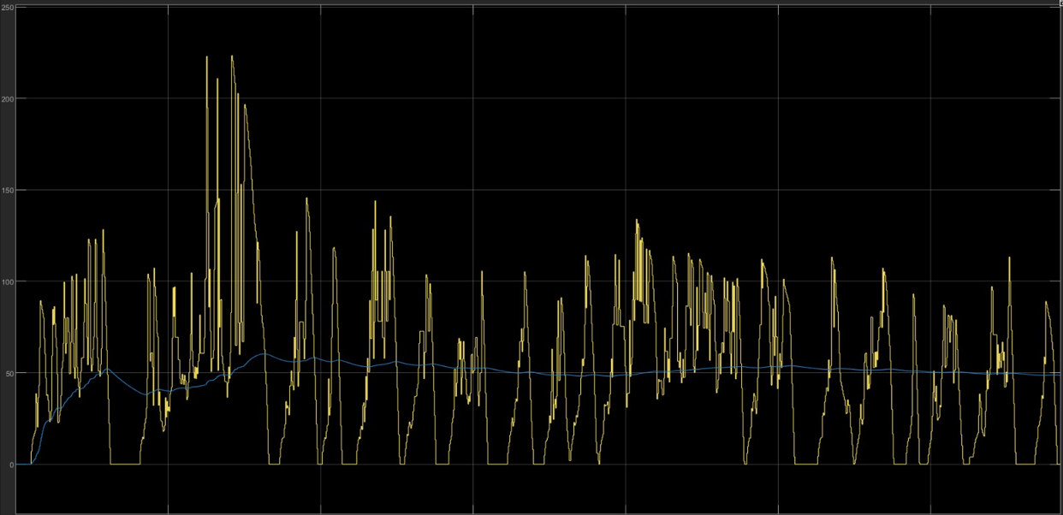
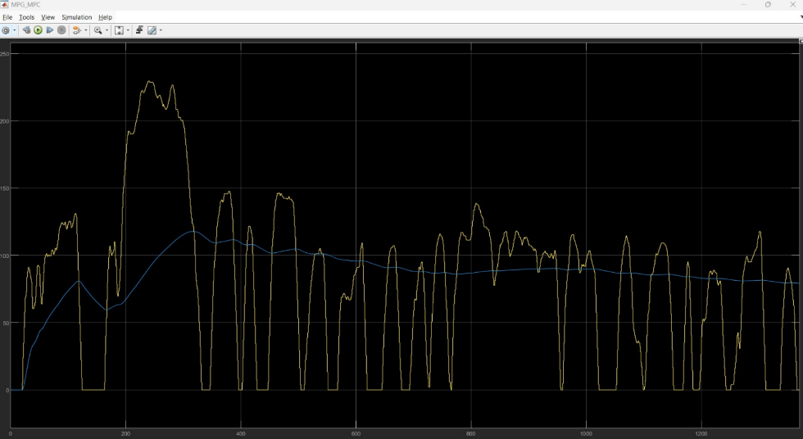
MPG (50-50 vs MPC)
Higher peaks and higher average MPG (trend line shifted upward)
Smoother long-term fuel consumption behavior

Slide 25
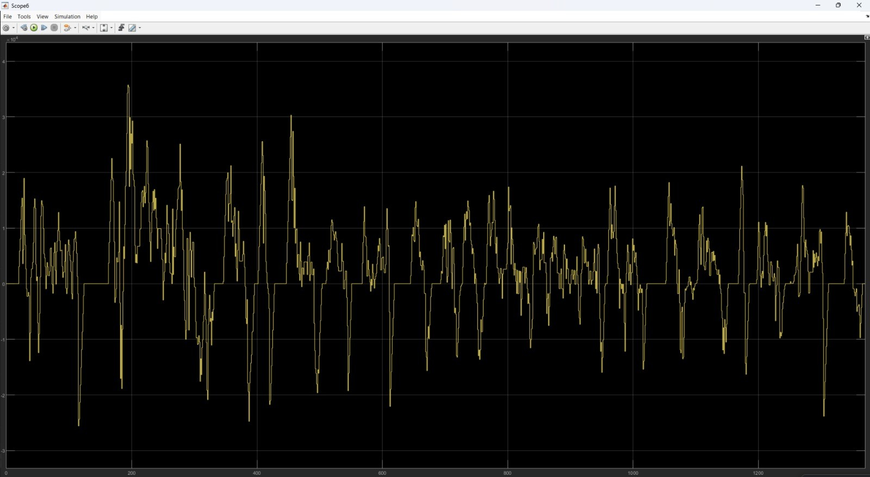
Power at wheel

Slide 26
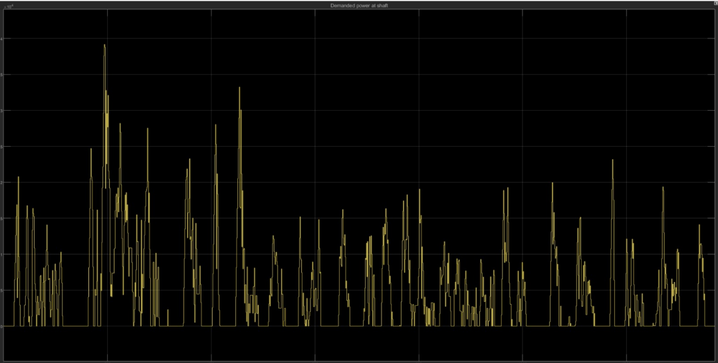
Power at shaft

Slide 27
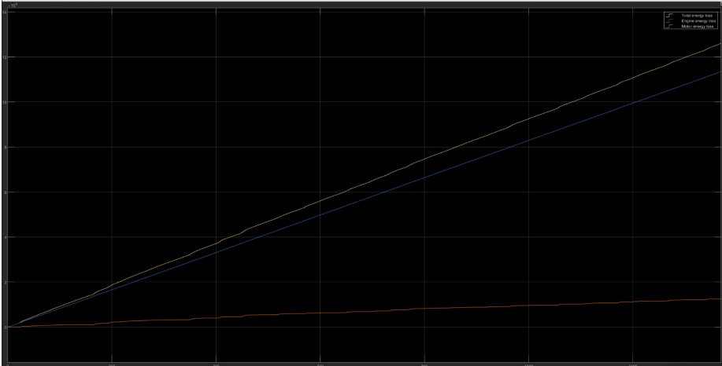
Total Energy loss with LTI MPC

Slide 28
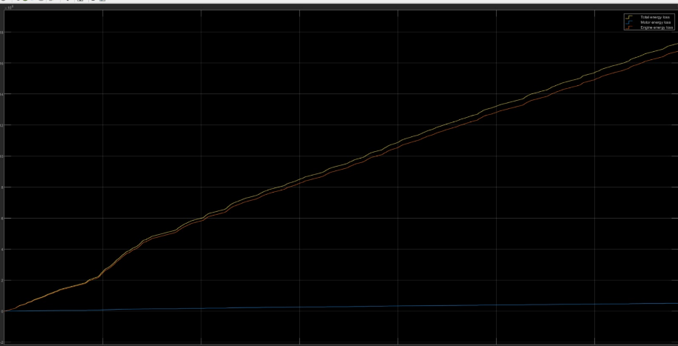
Total Energy loss with 50-50 controller

Slide 29
CONCLUSION

Slide 30
Conclusion
This project successfully implemented and compared two hybrid energy-management strategies Rule-Based (RB) control and Model Predictive Control (MPC) using a backward looking vehicle model with realistic engine, motor, and battery subsystem maps.
Key Achievements
Integrated backward looking model
Design a backward looking model based of the longitudinal dynamics.
Built a battery components to simulate the change in SOC
Design the power train model to simulate the losses.
Implemented two energy-management controllers:
Rule-Based (50/50 split) for torque/power allocation
MPC controller solving a constrained quadratic optimization problem over a prediction horizon
Computed both instantaneous and average MPG using real-time vehicle speed and fuel flow.

